Slide 1
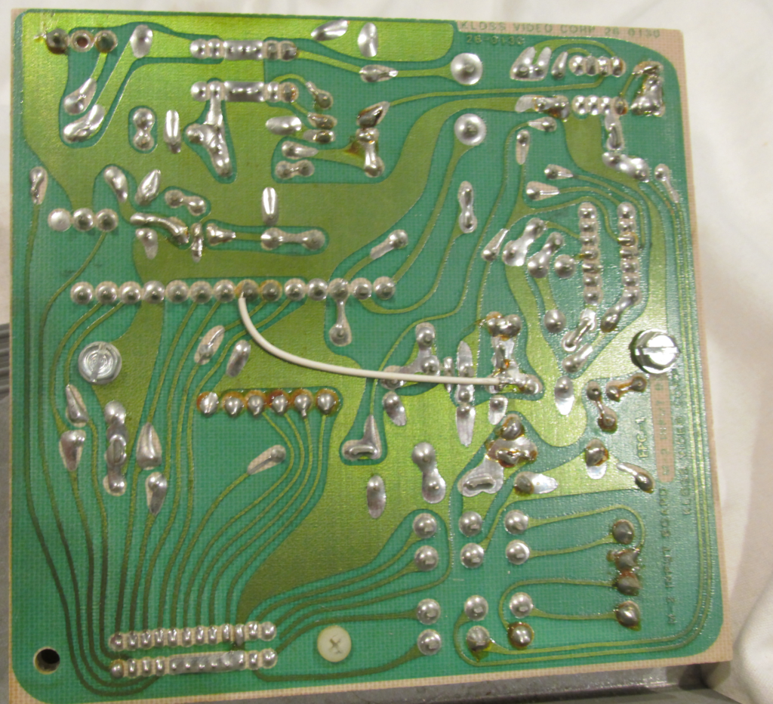
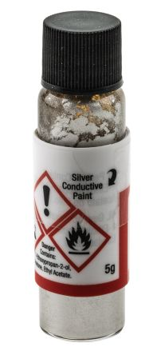
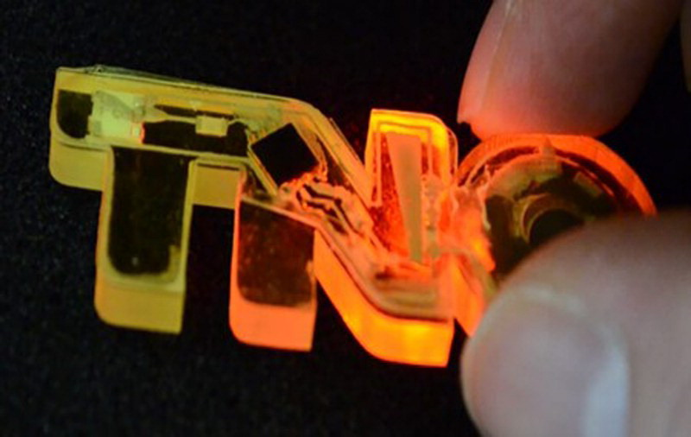
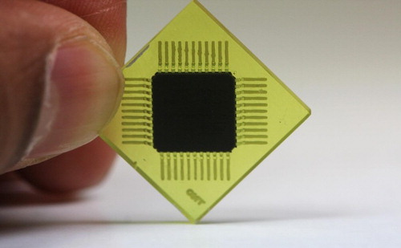
Embedded electronics in mechanical structures
Current technology integrates electronics into Printed Circuit boards(PCB), fiber glass boards with layers of copper between them that conduct current to form a circuit. PCBs, produced in mass quantities, are formed by selectively etching away copper to from conductive tracks. PCBs usually have a planar form factor with components soldered on to the top and bottom layer.
With the advent of widely used 3D printing technology entering the market, it has opened the way for experiments integrating electronics into virtually any shape, unlike purely planar PCBs
Experiments by Hessel H. H. Maalderink et. al. in the Netherlands have yielded successful integration of surface mount components into the structure of Stereo Lithography (SLA) printed parts. In their paper, they demonstrated that it is possible to pause an SLA print, deposit conductive paste along tracks form reliable connections between components, and carry on the print to cover the tracks.
We have replicated the findings by Maalderink et. Al and extended this method by integrating electronics into the structure of our drifters.
Notes:
Hand etched pcb credit: By Tpdwkouaa - Own work, CC BY-SA 4.0, https://commons.wikimedia.org/w/index.php?curid=46419569
https://www.tandfonline.com/doi/full/10.1080/14658011.2017.1418165?instName=Imperial+College+London dutch paper

